Slide 1
HEAP OVERFLOW
Submitted by:
Name- Ashutosh Soni
Id- 2018ucp1505

Slide 2
What is Heap Memory ?
Heap is a memory region allotted to every program. It is allocated dynamically means the program can request memory or release memory whenever it required. This memory is global means it can be accessed and modified form anywhere form the program. This can be reference dynamically by the pointers which results to small degradation in performance as compared to using local variables.
In C or C++ by using header file ‘stdlib.h’ we have some library functions to access, modify and manage dynamic memory. Some of the functions are
malloc(sizeof datatype) : This functions returns the pointer of the suitable return type mentioned.
calloc(number_of_blocks*sizeof(block)) : This function return the pointer of the first block of the array made.
3. free() : This will free the memory assigned by malloc and calloc function

Slide 3
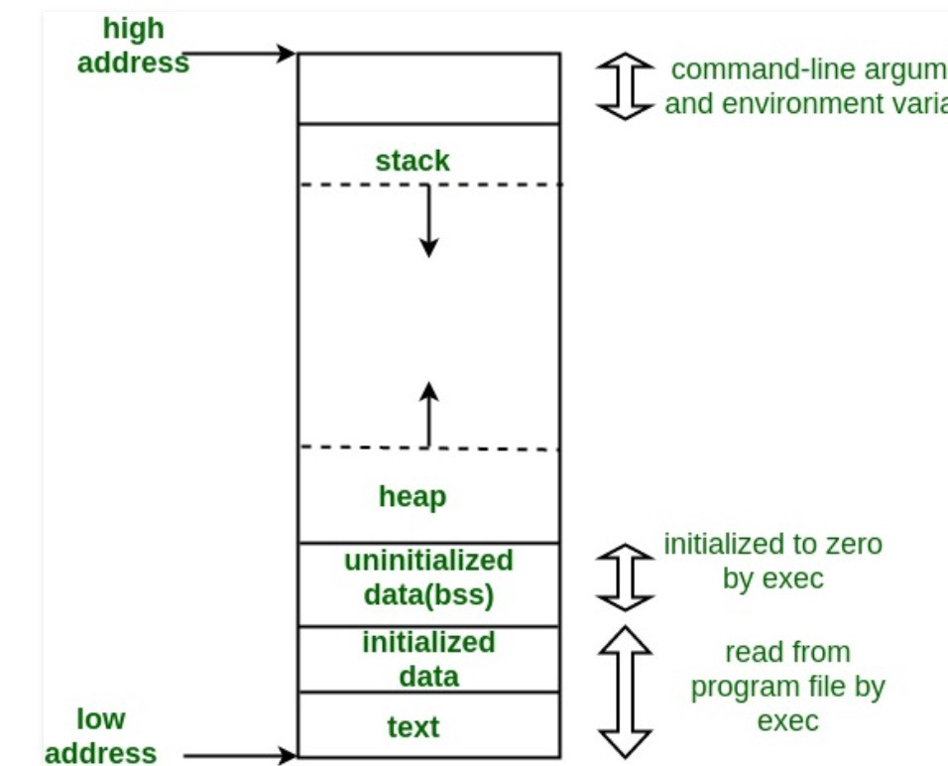
How heap is assigned in the Memory ?
Heap is assigned form low address side in the memory just below from the stack.
Heap grows form low address side to high address side just opposite in the fashion in which stack grows.

Slide 4
Heap Overflow
There are two main reasons for heap overflow
If we continuously allocating memory with the help of malloc, calloc or realloc and we do not free that memory space after use .. It may result in memory leakage means memory is still being in used but not available for other processes.
If we dynamically allocate large number of variables.

Slide 5
Impacts of Heap Overflow
The common consequences System may results in because of heap overflow are:
Availability: Heap overflows or buffer overflows generally lead to crashes. Other attacks leading to lack of availability are possible, including putting the program into an infinite loop.
Integrity Confidentiality Availability access Control: It often can be used to execute the arbitrary arbitrary code, which is usually outside the scope of a program's implicit security policy. Besides important user data, heap-based overflows can be used to overwrite function pointers that may be living in memory, pointing it to the attacker's code. Even in applications that do not explicitly use function pointers, the run-time will usually leave many in memory. For example, object methods in C++ are generally implemented using function pointers. Even in C programs, there is often a global offset table used by the underlying runtime.
Integrity Confidentiality Availability Access Control Other: When the consequence is arbitrary code execution, this can often be used to subvert any other security service.

Slide 6
Protection from Heap Overflow
We can minimize the heap overflow with the help of the following:
Strong programming languages
Frequent check of system behavior
Updating security mechanisms
Validating inputs and outputs

Slide 7
Thanks

